Slide 1
FinTech Progress Report
FinTech Group 3: Alex Chen, Ming-Yu Chi, Yao-Chieh Hu, Yue Hu, Chien-Hsun Huang, Nicolas Kardous

Slide 2
Agenda
Introduction
SeqGAN
Model 1: SeqGAN Pipeline
Model 2: Regular GAN
Future Work

Slide 3
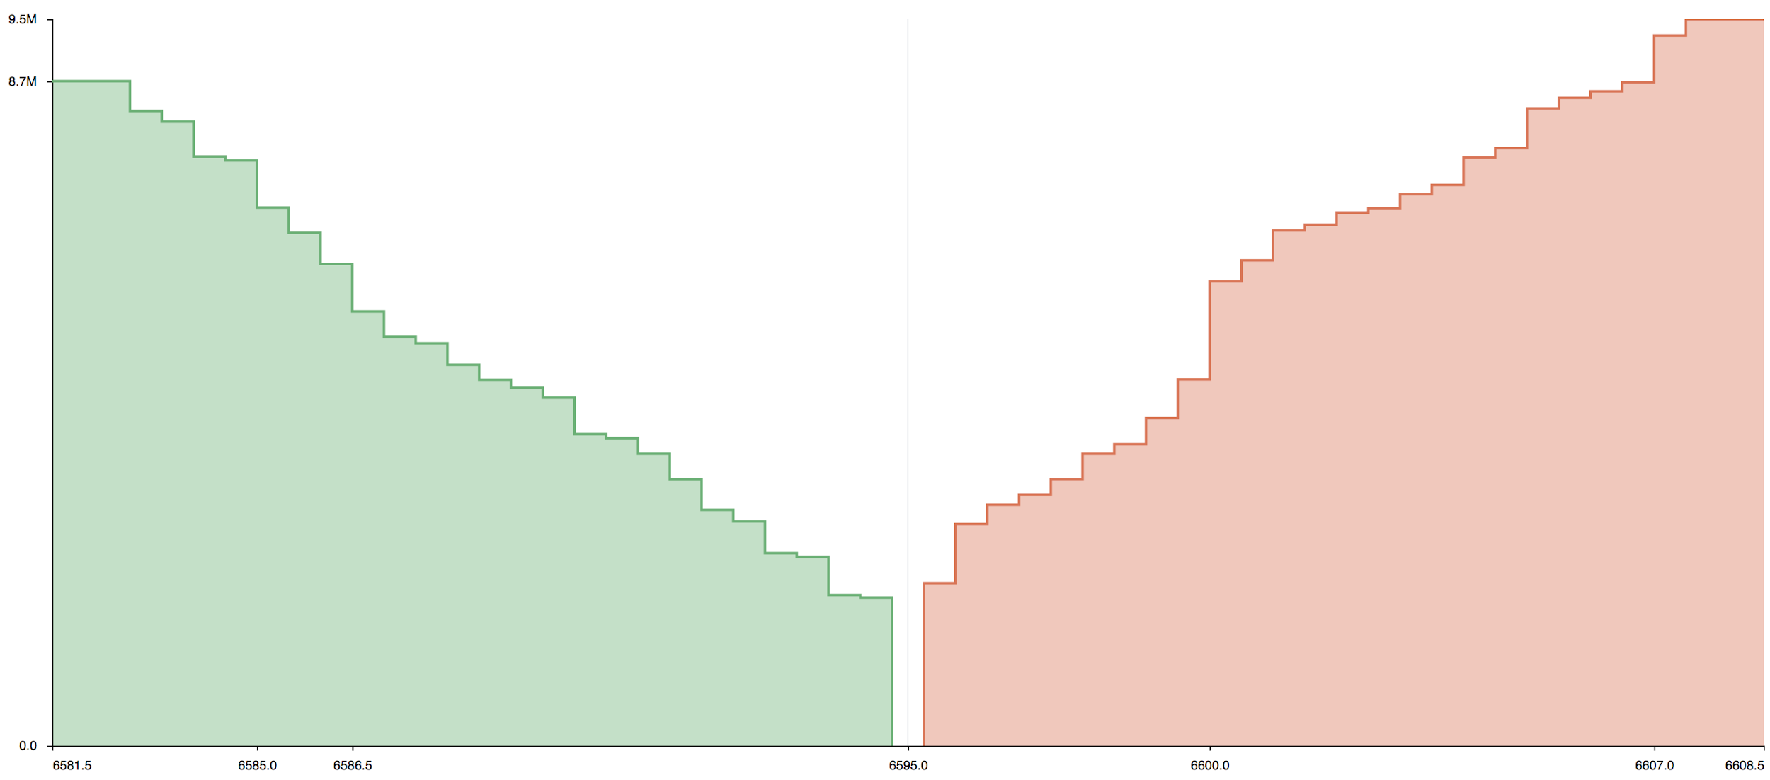
APPROACH: LOB + GAN
Financial Market
Machine Learning
GAN
SeqGAN

Slide 4
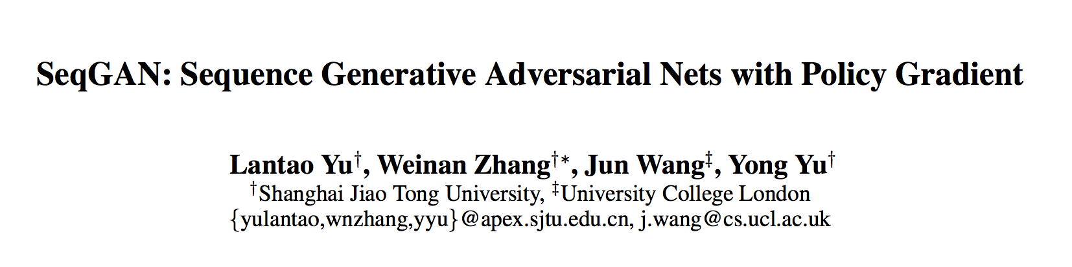

Slide 5
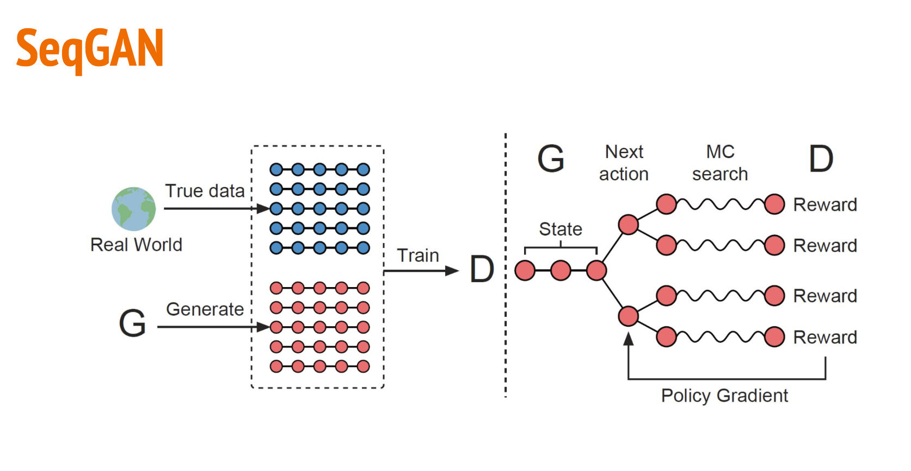



SeqGAN model

Slide 6
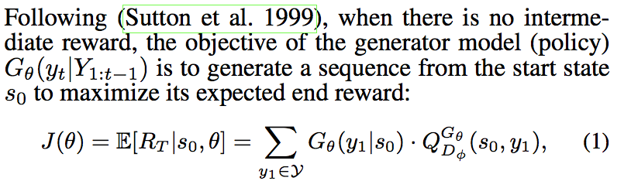
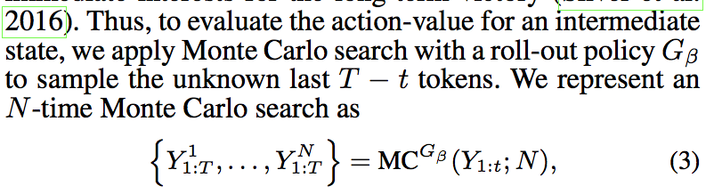
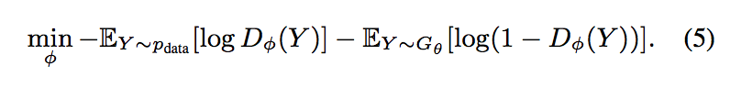
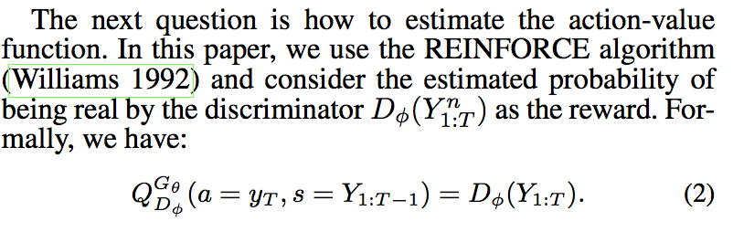
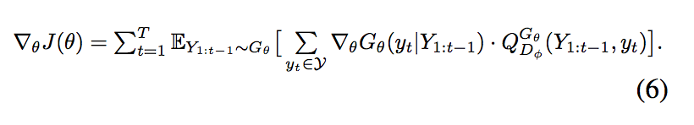

SeqGAN model
Notes:
Given a dataset of real-world structured sequences, train a θ-parameterized generative model Gθ to produce a se-quence Y1:T = (y1,...,yt,...,yT),yt ∈ Y, where Y is the vocabulary of candidate tokens.
In timestep t, the state s is the current produced tokens (y1 , . . . , yt−1 ) and the action a is the next token yt to select. Thus the policy model Gθ (yt |Y1:t−1 ) is stochastic, whereas the state transition is deterministic after an action has been chosen. Additionally, we also train a φ-parameterized discrimina- tive model Dφ (Goodfellow and others 2014) to provide a guidance for improving generator Gθ . Dφ (Y1:T ) is a prob- ability indicating how likely a sequence Y1:T is from real sequence data or not. Discriminative model Dφ is trained by providing positive ex- amples from the real sequence data and negative examples from the synthetic sequences generated from the generative model Gθ . At the same time, the generative model Gθ is up- dated by employing a policy gradient and MC search on the basis of the expected end reward received from the discrim- inative model Dφ. The reward is estimated by the likelihood that it would fool the discriminative model Dφ. The specific formulation is given in the next subsection.

Slide 7
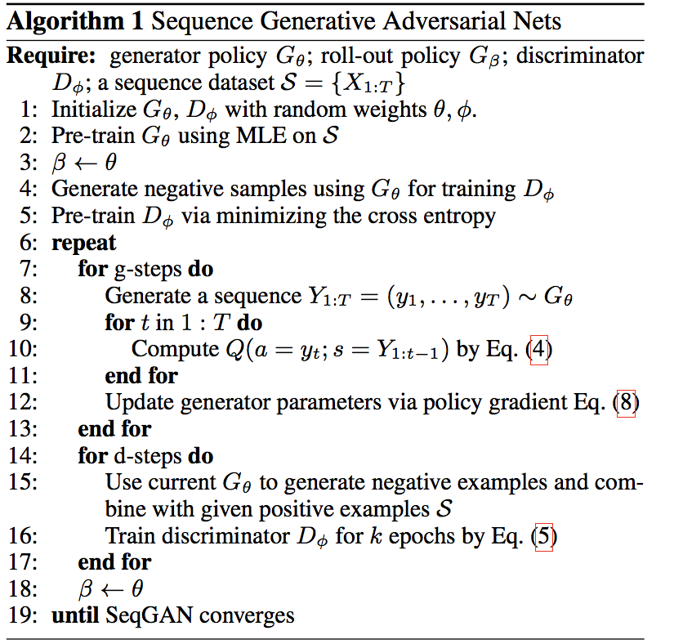
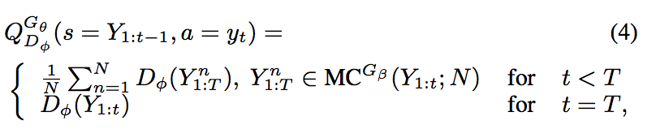
SeqGAN model

Slide 8
Pipeline
RAW
Data
Encode
Txt
SeqGAN
Txt
Decode
Generative Data

Slide 9
Encoding System
Type: 1- 7 -> 0 - 6
Direction: 1,-1 -> 0,1
Size: 100 - 1300 -> 0 - 12 for bin
Price: Bin
 | Type | Direction | Size | Price
1 | 3 | 1 | 200 | 1.1
2 | 4 | -1 | 300 | 1.2
3 | 5 | 1 | 1200 | 1.3
 | Type | Direction | Size | Price
1 | 2 | 1 | 1 | 1
2 | 3 | 0 | 2 | 2
3 | 4 | 1 | 11 | 2
Encoding:
7 × 2 × 13 × 10 = 1820

Slide 10
Test Environment: Texygen
Multiple GANs Toolbox:
SeqGAN
GSGAN: Discrete Sequence
Input: Txt file with sequence
Output: Txt file with sequence
We change some parameter in the structure.
GitHub: https://github.com/geek-ai/Texygen

Slide 11
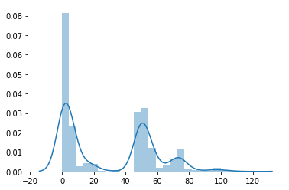
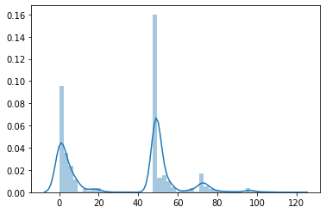
Input & output Comparison
We select 10000 data point to test
There are similar, but we still have the room to improve
Input: Raw LOB Data
Output: Generative Data

Slide 12
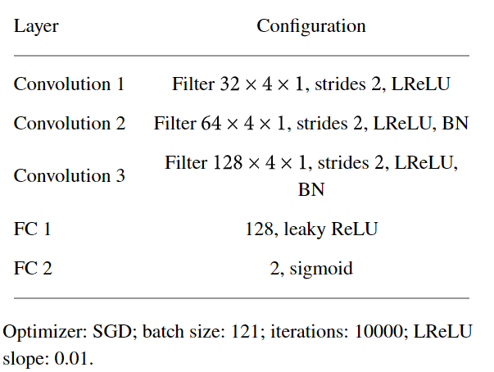
Regular GANs - Network Structure
Generative Model G
Inputs include past closing price Y = {y1, y2 ,..., yT } and technical indicators X
Capture the underlying distribution and output ỹt+1
Discriminative Model D
estimates the probability that a sample came from the training data rather than 𝐺

Slide 13

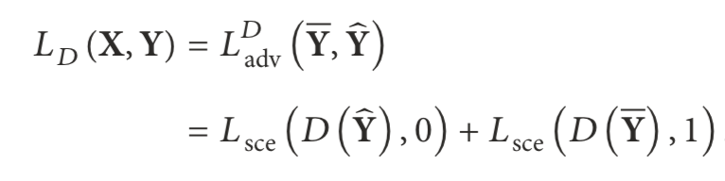

Regular GANs - Loss Function
Training G
Minimize Adversarial Loss to confuse D
Training G
Minimize Adversarial Loss to confuse D
Training D
Minimize Adversarial Loss
Training D
Minimize Adversarial Loss
Minimize RMSE loss to decrease forecast error loss
Minimize RMSE loss to decrease forecast error loss

Slide 14
Future Work
Parameters to change
Numbers of item for one Sequence
The bin size for continuous feature
Like bin size for price
Like bin size for trade size
Encoding System
More Model to test
Combine our own SeqGAN

Slide 15
THANK YOU

